Slide 1
TRAVEL TOURISM AND HOSPITALITY
- Travel . Experience. Live

Slide 2
TEAM MEMBERS
2100030923
2100031023
2100030954

Slide 3

TRAVEL
Travel is the movement of people between distant geographical locations . Travel can be done by foot, bicycle, automobile, train, boat, bus, airplane, ship or other means, with or without luggage, and can be one way or round trip . Travel can also include relatively short stays between successive movements, as in the case of tourism.
This Photo by Unknown Author is licensed under CC BY-ND

Slide 4
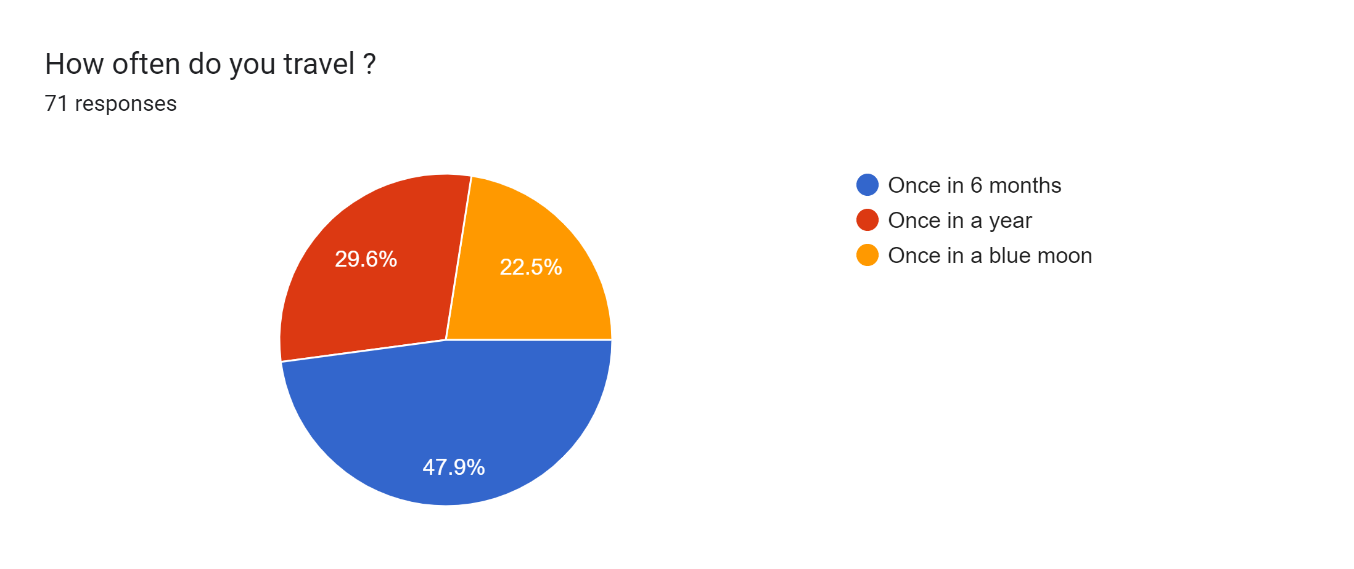
SURVEY
-On how often do people travel.

Slide 5
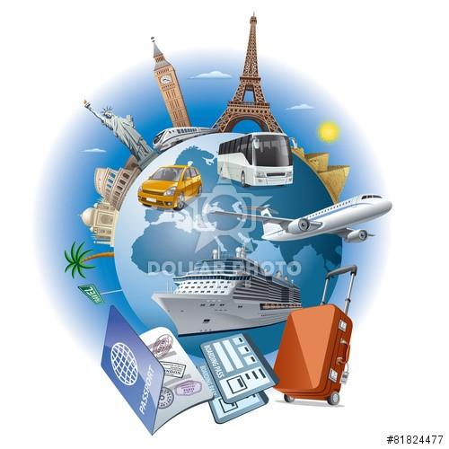
TOURISM
Tourism is a social, cultural and economic phenomenon which entails the movement of people to countries or places outside their usual environment for personal or business/professional purposes.

Slide 6
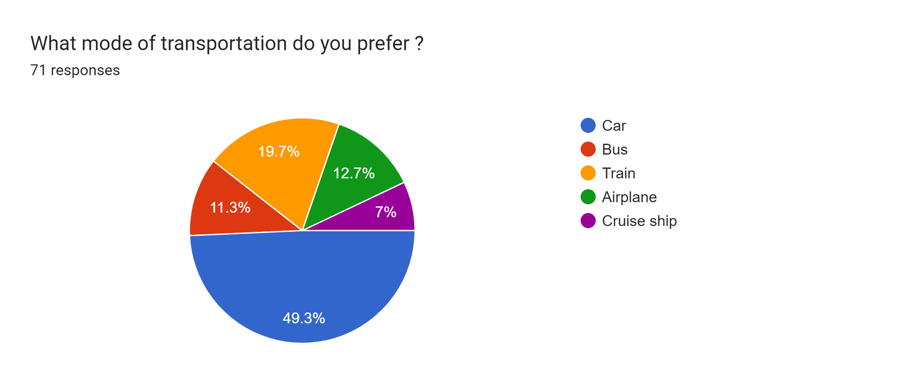
SURVEY
-On what mode of transportation people prefer to travel the most.

Slide 7

HOSPITALITY
Hospitality is the relationship between a guest and a host, wherein the host receives the guest with some amount of goodwill, including the reception and entertainment of guests, visitors, or strangers. Hospitality is also the way people treat others, that is, the service of welcoming receiving guests for example in hotels.

Slide 8
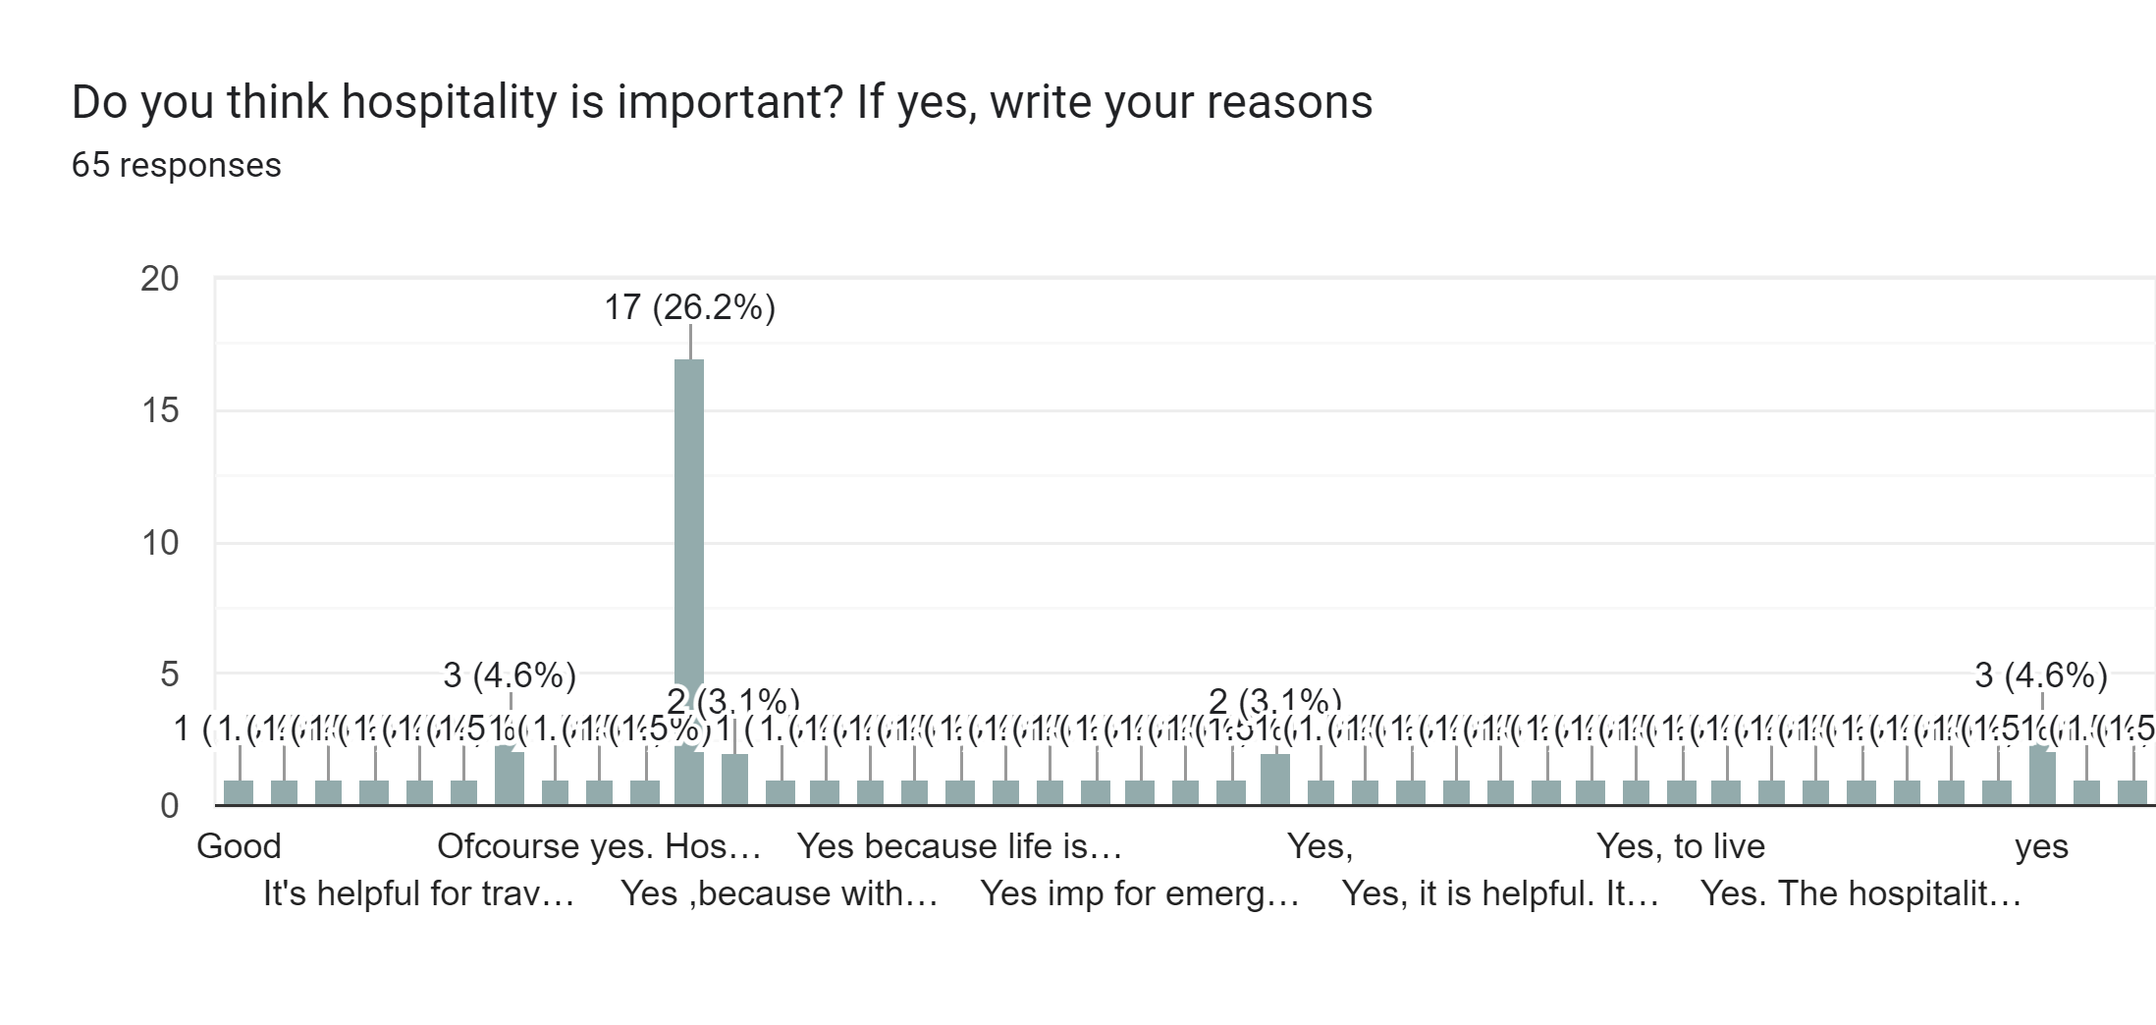
SURVEY
-On hospitality really important?

Slide 9
Travel, Tourism and hospitality
The travel and tourism industry does not sell one specific product, rather, it incorporates many industries. These include leisure travel, business travel, accommodation, food and drink services, and more. Within these industries there are many markets such as hotels, short-term rentals, cruises, meetings and events, and the online travel market .
It simply includes:
Accommodation
Business Travel
Food & Drink Services
Leisure Travel

Slide 10
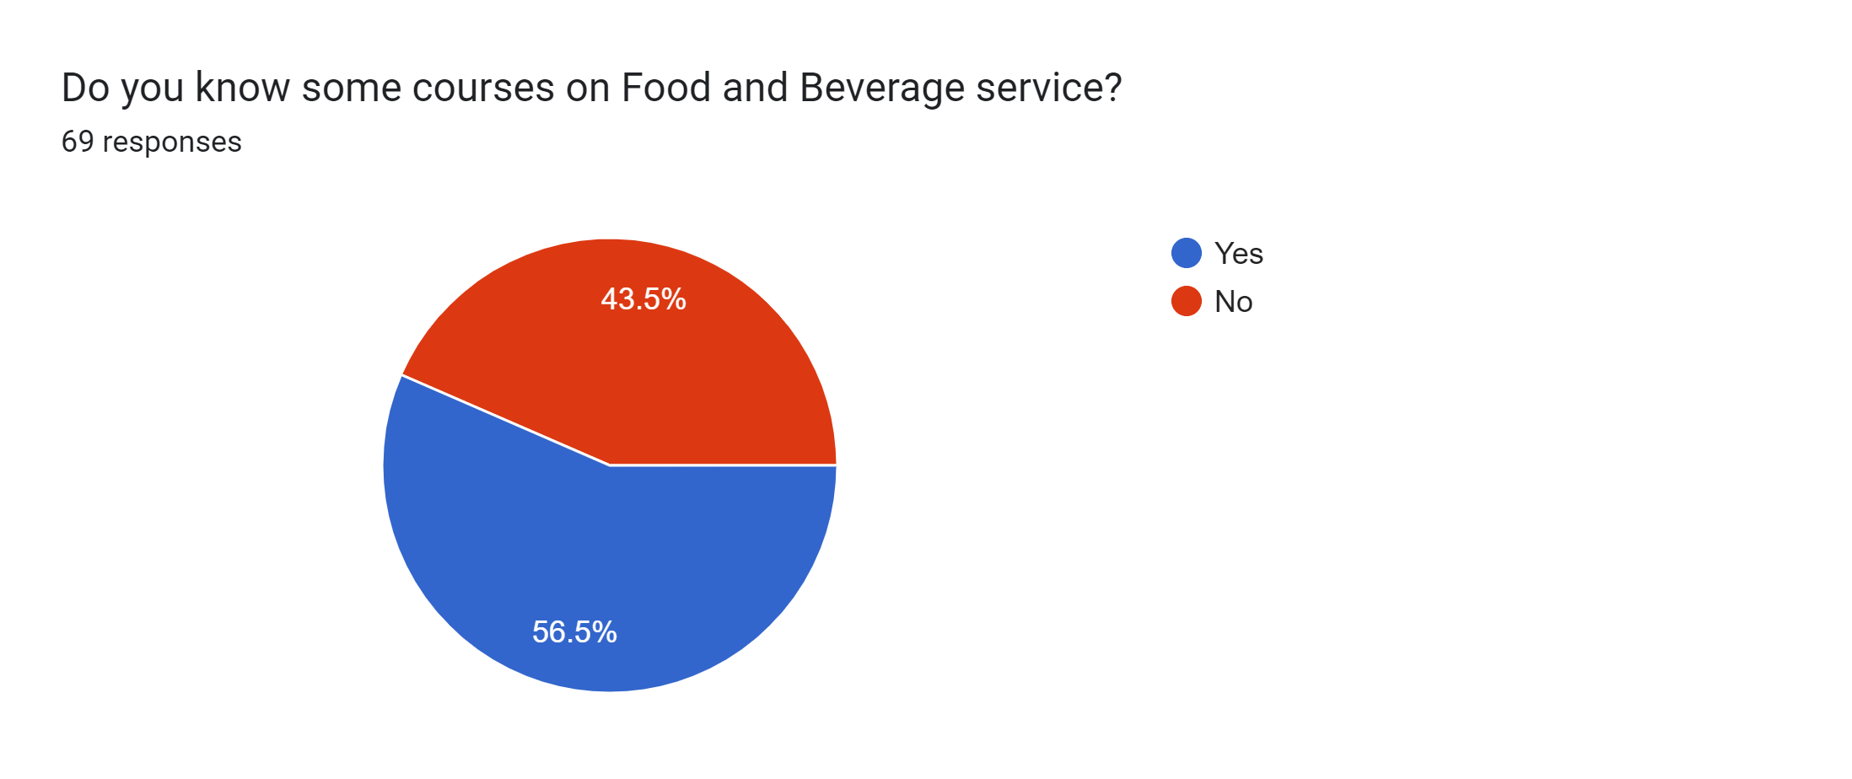
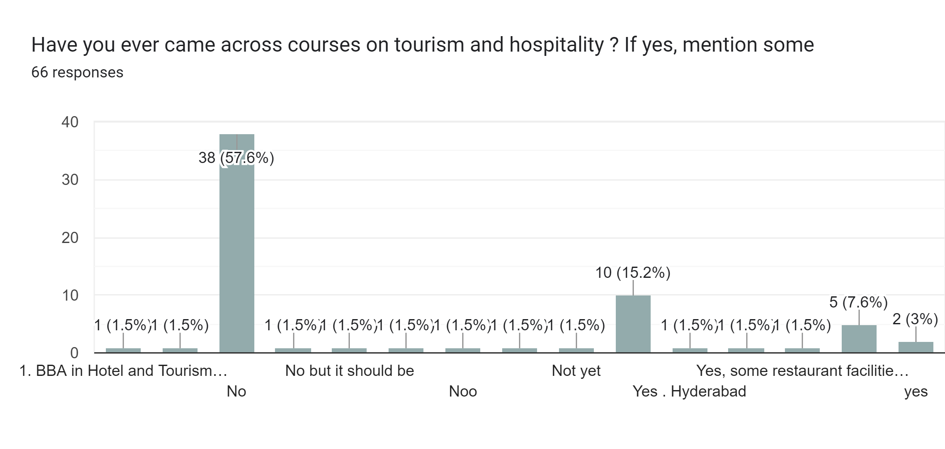
SURVEY
-Are people aware of courses on travel , tourism and hospitality.

Slide 11
THANK YOU!

